Slide 1


Department of Computer Science and Engineering
CS19643 – Project
CUTANEOUS CANCER DETECTION SYSTEM
Dr.S. Vinodkumar
Professor
Ananya N(210701027)
Abdul Hazeer T(210701007)
Ashik Mohammed Y(210701035)

Slide 2
Abstract
Skin cancer, particularly melanoma, is recognized as one of the most hazardous forms of cancer affecting humans. Early detection of melanoma is crucial for effective treatment and prognosis, as it is the most unpredictable subtype of skin cancer. Leveraging advancements in computer vision and machine learning, this project proposes an automated system for the classification of melanoma skin lesions as either malignant or benign. The methodology employs a comprehensive dataset comprising diverse images of both malignant and benign melanoma cases, which are fed into a machine learning algorithm implemented using TensorFlow and Keras frameworks. Through convolutional neural networks (CNNs), the model learns to extract discriminative features from the images, enabling accurate classification. Preprocessing techniques are applied to enhance image quality and feature extraction.

Slide 3
Existing System
Traditional methods of skin cancer diagnosis primarily rely on visual inspection by dermatologists, which can be subjective, time-consuming, and potentially prone to errors. Dermatologists typically employ a combination of clinical examination, dermoscopy (skin surface microscopy), and sometimes biopsy for definitive diagnosis. While these methods are effective, they may not always provide consistent and accurate results, especially in cases where lesions are difficult
To address the limitations of traditional diagnostic approaches, several computer-aided diagnosis (CAD) systems have been developed, leveraging advancements in machine learning and computer vision. These systems aim to assist dermatologists in improving diagnostic accuracy and efficiency. One such existing system is the MoleScope™, a handheld dermoscopy device that integrates with a smartphone application to capture and analyze skin lesions
Another notable example is the SkinVision app, which allows users to photograph skin lesions using their smartphone camera and receive instant risk assessments for melanoma and other types of skin cancer. SkinVision employs a combination of image analysis algorithms and clinical expertise to classify lesions as low or medium.

Slide 4
Proposed System
The proposed system aims to develop an advanced automated skin cancer diagnosis system using state-of-the-art machine learning techniques, specifically focusing on the classification of melanoma skin lesions as either malignant or benign. The system will leverage a comprehensive dataset containing a diverse range of melanoma images, encompassing various stages, sizes, and manifestations of the disease.
The core component of the proposed system is a deep learning model based on convolutional neural networks (CNNs), implemented using TensorFlow and Keras frameworks. CNNs have demonstrated remarkable success in image classification tasks and are well-suited for analyzing complex visual data such as skin lesion images. The model will be trained on the dataset, learning to extract discriminative features that differentiate between malignant and benign lesions. To enhance the performance and robustness of the model, various preprocessing techniques will be employed, including image normalization, augmentation, and noise reduction. These techniques will help standardize the input data and augment the training dataset, thereby improving the model's ability to generalize.

Slide 5
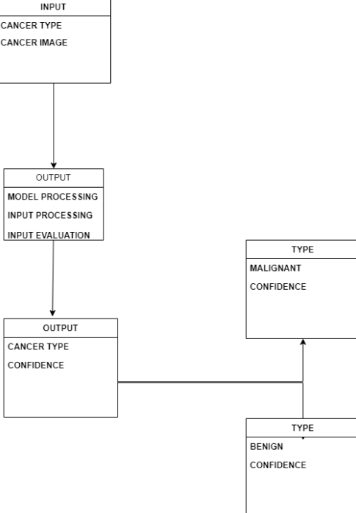
System Architecture

Slide 6
List of Modules
Data preprocessing module
Feature extraction module
Model training module
Model evaluation module

Slide 7
Functional Description for each modules
Data Preprocessing Module:
The data preprocessing module serves as the initial step in the skin cancer classification pipeline, responsible for preparing the input data for subsequent processing and model training. It begins by sourcing a diverse dataset of skin lesion images, encompassing both benign and malignant cases. Upon data acquisition, the module proceeds with essential preprocessing tasks, including image loading, resizing, and normalization to ensure uniformity in image dimensions and pixel values. Additionally, data augmentation techniques such as rotation, flipping, and zooming are applied to augment the dataset, enhancing its diversity and robustness. Furthermore, the dataset is partitioned into training, validation, and testing subsets to facilitate model training, validation, and evaluation phases.

Slide 8
Functional Description of Module
Feature Extraction Module:
The feature extraction module focuses on extracting discriminative features from skin lesion images to capture essential characteristics relevant for classification. Leveraging deep learning architectures, such as convolutional neural networks (CNNs), pretrained models like VGG, ResNet, or Inception are employed to automatically learn hierarchical features from the input images. Transfer learning techniques may also be utilized to fine-tune these pretrained models on the skin cancer dataset, enhancing their ability to extract task-specific features. Additionally, handcrafted feature extraction methods, such as texture analysis or shape descriptors, may complement CNN-based approaches to capture complementary information from the images. By extracting informative features, this module aims to encode the inherent characteristics of skin lesions, enabling the subsequent classification model to make accurate predictions distinguishing between benign and malignant cases.

Slide 9
Functional Description of Module
Model Training Module:
The model training module is integral to the skin cancer classification system, responsible for training machine learning models to accurately classify skin lesion images as benign or malignant. It involves selecting an appropriate classification algorithm, such as support vector machines (SVM), random forests, or deep neural networks, based on the dataset characteristics and task requirements. The module begins by preprocessing the data and extracting relevant features from the skin lesion images, preparing them for model training. Subsequently, the selected classification algorithm is trained on the preprocessed data, optimizing its parameters to minimize the classification error. Techniques such as cross-validation may be employed to assess model performance and prevent overfitting. The trained model is then evaluated on a separate validation dataset to ensure its effectiveness in generalizing to unseen data.

Slide 10
Functional Description of Module
Model Evaluation Module:
The model evaluation module assesses the performance of the trained machine learning model on unseen data to evaluate its effectiveness in classifying skin lesion images as benign or malignant. It employs a range of evaluation metrics, including accuracy, precision, recall, F1-score, and area under the receiver operating characteristic (ROC) curve, to comprehensively evaluate the model's classification performance. The module conducts thorough analysis and visualization of evaluation metrics to gain insights into the model's strengths and weaknesses. Additionally, it generates visual aids such as confusion matrices, ROC curves, and precision-recall curves to visualize the model's performance across different thresholds. Furthermore, techniques such as stratified sampling and bootstrapping may be employed to ensure the reliability and robustness of the evaluation results.

Slide 11
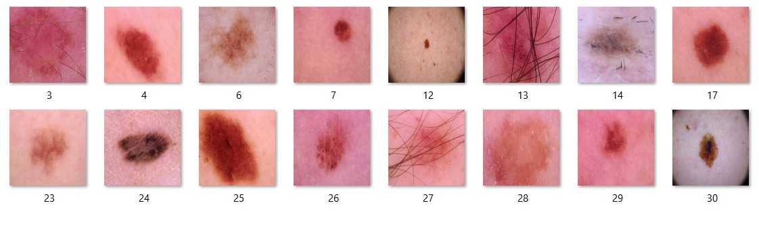
Benign Dataset

Slide 12
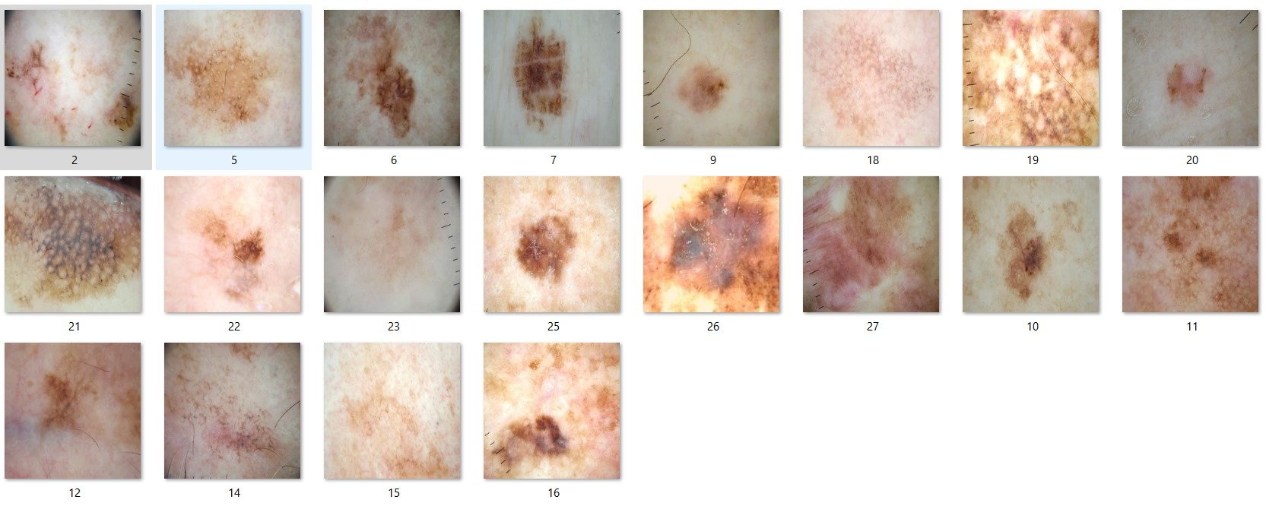
Malignant Dataset

Slide 13
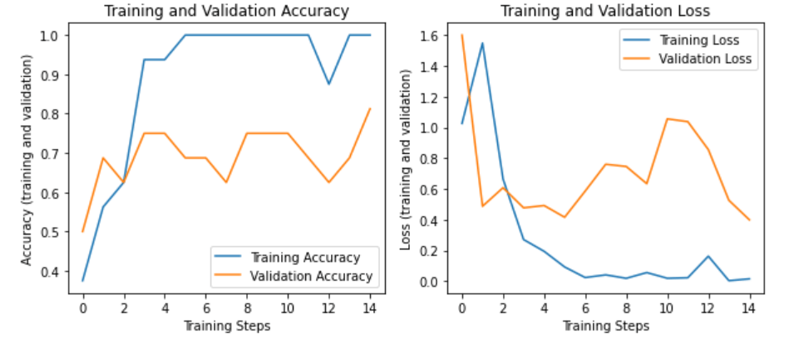
Graph results

Slide 14
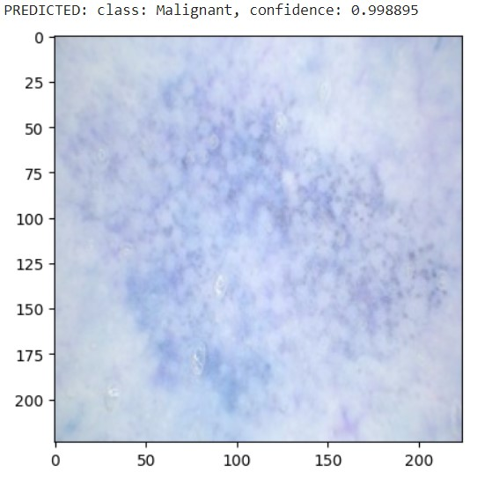
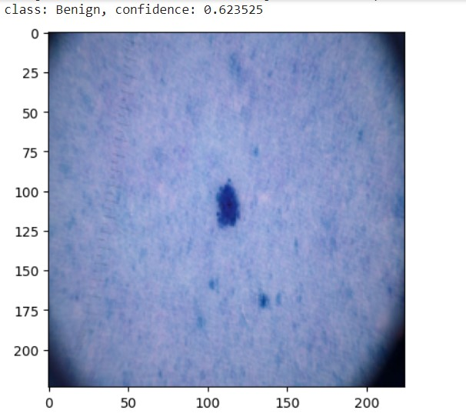

Slide 15
Conclusion
In conclusion, the skin cancer classification system represents a comprehensive solution for accurately distinguishing between benign and malignant skin lesions, leveraging advanced machine learning techniques and image analysis algorithms. Through a systematic approach encompassing data preprocessing, feature extraction, model training, and evaluation, the system aims to provide clinicians and healthcare professionals with a reliable tool for early detection and diagnosis of skin cancer. By effectively preprocessing and extracting informative features from skin lesion images, the system lays the groundwork for training robust machine learning models capable of accurately classifying lesions.
The iterative process of model training and evaluation ensures that the classification model achieves high accuracy and generalization performance, validated through rigorous assessment using diverse evaluation metrics and techniques. Furthermore, the system's emphasis on error analysis and refinement enables continuous improvement, addressing challenges and limitations encountered during model development and deployment. Ultimately, the skin cancer classification system holds significant potential to enhance clinical decision-making, improve patient outcomes, and facilitate timely intervention for individuals at risk of developing skin cancer

Slide 16
References
1. Esteva, A., Kuprel, B., Novoa, R. A., Ko, J., Swetter, S. M., Blau, H. M., & Thrun, S. (2017). Dermatologist-level classification of skin cancer with deep neural networks. Nature, 542(7639), 115-118.
2. Brinker, T. J., Hekler, A., Enk, A. H., Klode, J., Hauschild, A., Berking, C., ... & Schadendorf, D. (2019). Deep learning outperformed 136 of 157 dermatologists in a head-to-head dermoscopic melanoma image classification task. European Journal of Cancer, 113, 47-54.
3. Tschandl, P., Rosendahl, C., & Kittler, H. (2019). The HAM10000 dataset, a large collection of multi-source dermatoscopic images of common pigmented skin lesions. Scientific Data, 6(1), 1-8.

Slide 17
Thank You

